Slide 1

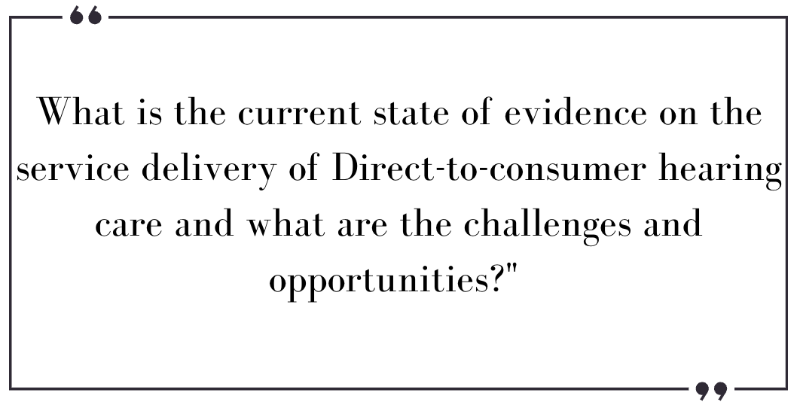
“Challenges and Opportunities in Service Delivery of Direct-to-Consumer Hearing Technology: A Scoping Review”
Harini Madhu, Millie R. Kirkwood, Amir Hussain, Alison Porter-Armstrong, Adele M. Goman
Edinburgh Napier University, Healthcare Technology Research Group, School of Health and Social Care
Introduction
Direct-to-consumer hearing services are relatively new platform where the individuals with hearing loss can opt for a hearing devices without a professional guidance (1). The study focuses on mapping the existing literature on direct hearing healthcare and analyzing the reported barriers and opportunities to address them to improve the uptake of hearing technology. Hence, this scoping review was designed to analyze the reported challenges and opportunities in available literature on service delivery of direct-to-consumer hearing services
Results
Lack of professional support
Limited awareness and understanding of technology
Safety
Trust
Threat to clinical practice
Opportunities
Integration of direct-to-consumer services into audiological clinical practice
Interprofessional collaboration
Need for increased awareness and understanding of stakeholders
Comparing traditional practice with DTC service delivery
Barriers
Discussion
This study is an important step in considering what researchers need to know about the existing evidence on challenges and opportunities that this model faces in order to address them and find innovative solutions to increase the uptake of hearing technology.
Methodology
The scoping review followed Arksey & O’Malley’s five-stage framework (2005) with reference PRISMA-ScR checklist. The initial search identified 5864 studies, after the duplication and screening process, 72 articles were eligible for full-text review. After thorough evaluation, 14 articles were selected to be relevant in reporting the current state of evidence on the service delivery of Direct-to-consumer hearing care.
Geographical distribution
11 – United states 1- United Kingdom
1-Australia 1- New Zealand
Patient view’s on D-T-C services
Provider opinion
Patient education
Policy changes
Future study focus
References
Manchaiah, V., Taylor, B., Dockens, A. L., Tran, N. R., Lane, K., Castle, M., & Grover, V. (2017a). Applications of direct-to-consumer hearing devices for adults with hearing loss: A review. Clinical Interventions in Aging, 12, 859–871. https://doi.org/10.2147/CIA.S135390
Arksey, H., & O’malley, L. (2005). Scoping studies: towards a methodological framework. International Journal of Social Research Methodology, 8(1), 19–32. https://doi.org/10.1080/1364557032000119616

